Slide 1
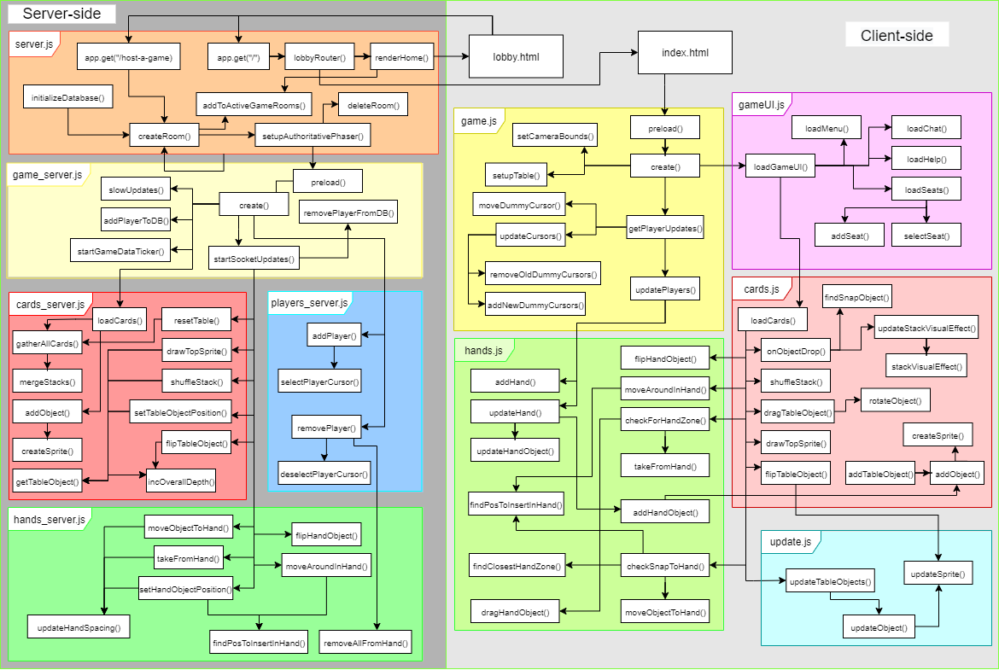
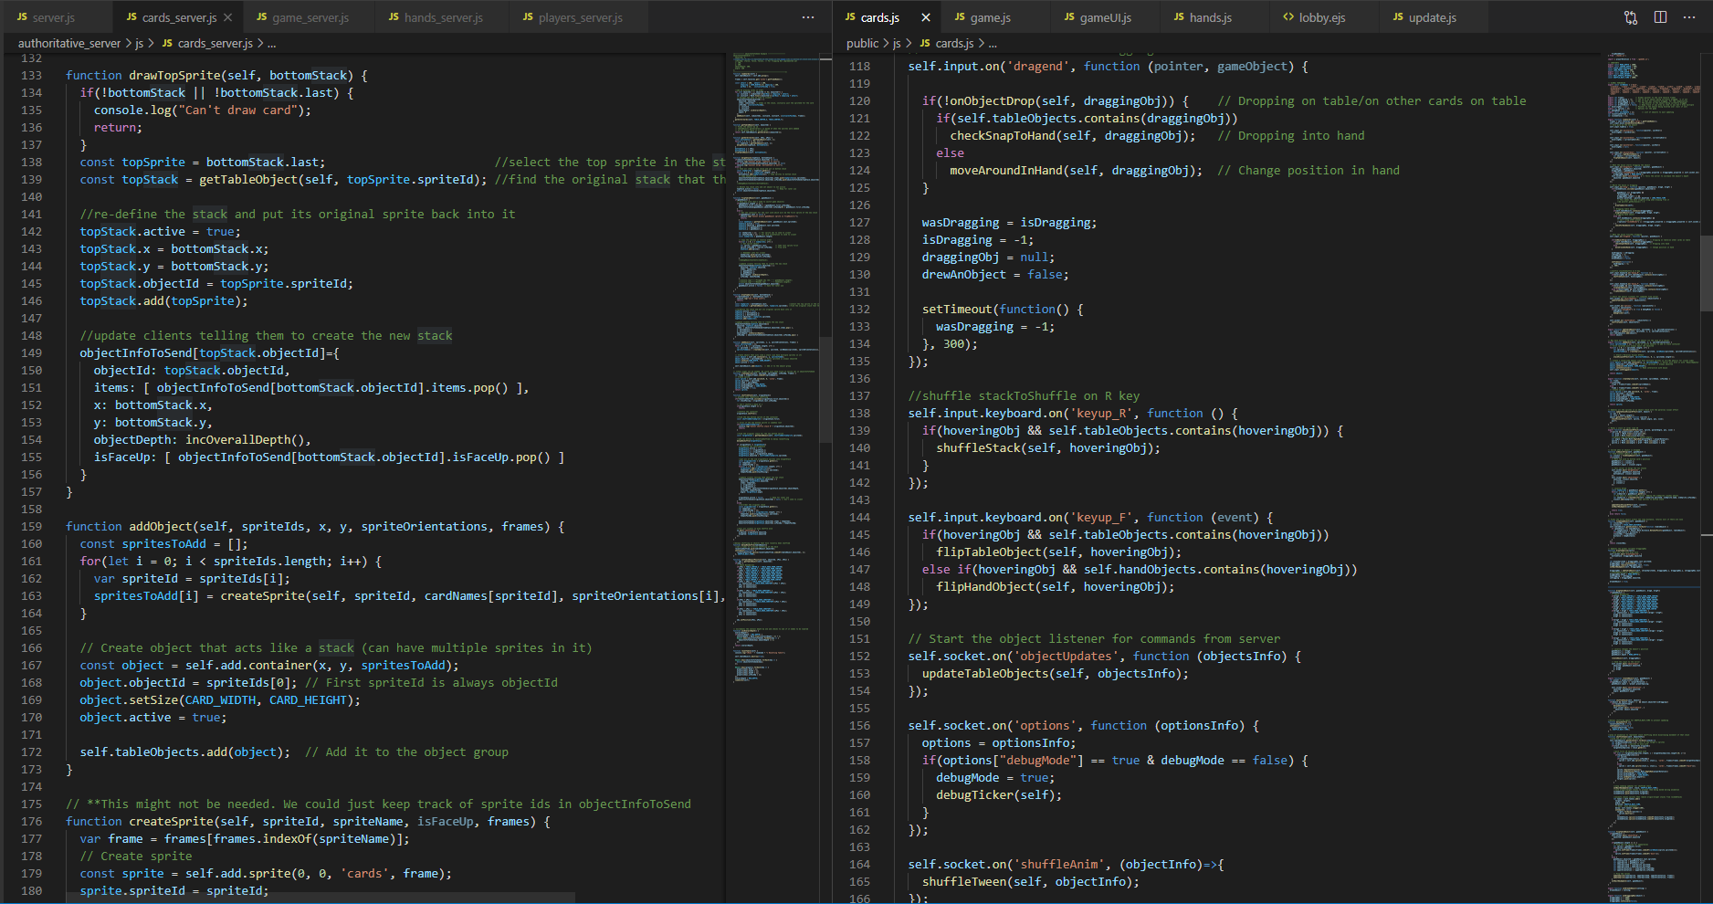


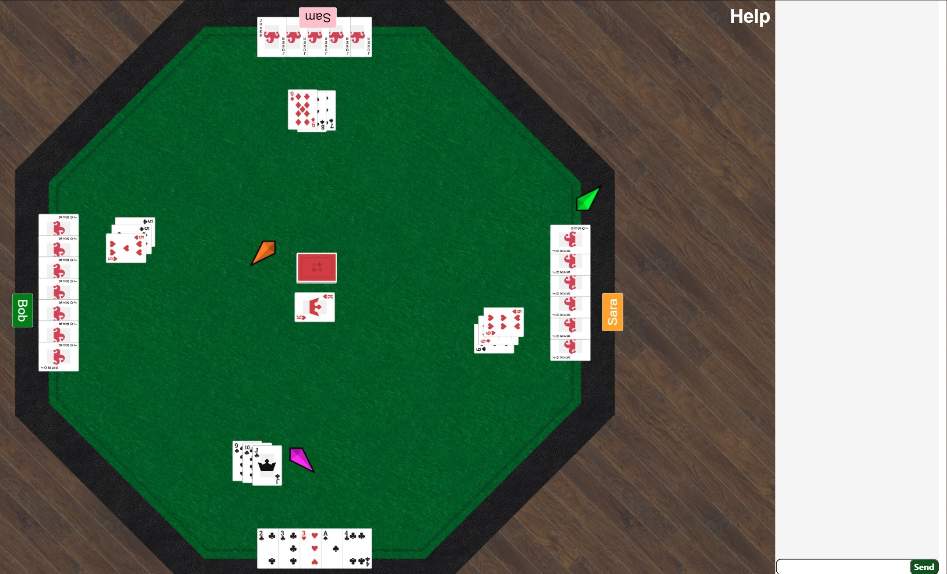
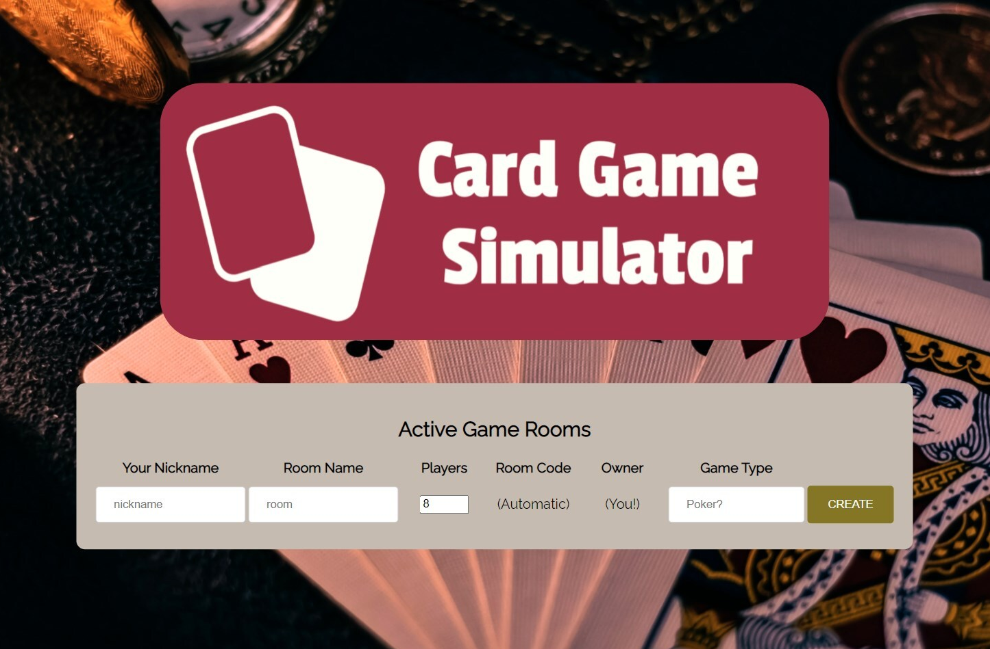

Card Game Simulator
Intention
In a time of pandemic, unrest, and isolation, perhaps a game of cards with friends can provide relief and entertainment. Card Game Simulator creates a simple interface for browser-based online card games.
Provide a free, browser-based digitally networked simulation of playing traditional card games with friends in a time where sharing the same physical table is neither safe nor responsible
Allow each player the following: A hand to store their personal cards in, a means of communication, name tags, a means of sharing game rooms to invite new players, the ability to manipulate cards on the table as would be needed for a real-life card game
Team
Jonathan Raines
BS in Computer Science
BS in Psychology
jonathan.s.raines@gmail.com
https://www.linkedin.com/in/jonathan-s-raines/
https://github.com/jonathan-raines
Design
Code
Thomas Sugimoto
The basic design for our application hosts a single central server which creates a child branch serving each game room which is created. This child maintains an array of the connected 8 player sockets to the main server and services them in turn maintaining the authoritative game state which is pushed to each of the client players in periodic updates to keep all players in sync updating the game state based on information sent from the players.
Our code base has been formed and refactored as needed for organizational purposes using comments frequently for ease of use and separating sections of code based on similar purposes when necessary. We made a point of trying to always use new functions as often as possible when adding new features for easier integration into the main branch of our repository. We also always attempted to use the most legible options available when writing code in order to ease understanding of features for our teammates.
BS in Computer Science
BS in Physics
sugimotothomas@gmail.com
https://www.linkedin.com/in/thomas-sugimoto/
Results
Phillip Wellheuser
An operational version of our application is available to the public online now with game rooms of 8 players using a standard traditional card deck without Joker cards available. Players can, join games via an open lobby, draw cards, stack cards, place cards in their hands as well as each others, shuffle cards, flip cards over, zoom in and out, pan the camera, change their nicknames, and chat with one another via text.
Our final product is available at: https://card-game-simulator.herokuapp.com/
Our codebase up to the point of submission can be found here: https://github.com/jonathan-raines/cs467-card-game-simulator
Moving forward, we will be moving our repository to this location: https://github.com/jonathan-raines/cs467-card-game-simulator UPDATE THIS WITH NEW REPO
BS in Computer Science
BS in Video Game Design
phillip.wellheuser@gmail.com
https://www.linkedin.com/in/phillipwellheuser
https://github.com/wellheup
https://www.phillipwellheuser.com/
Lobby
Game Room

